Slide 1

BAN 612 Project Presentation
Theaters vs. Streaming: What Predicts Success
Prepared by
Samadrita Roy Chowdhury

Slide 2

02
Table of
03
Problem & Goals
04
Data & Cohorts
Contents
05
Data Cleaning & Preparation
06-08
EDA and it’s Highlights
09
Theatrical Model (Elastic Net)
10
Streaming Model (Gradient Boosting)
11
What Drives Outcomes (SHAP & PDP)
12
Insights
13
Conclusions & Recommendations

Slide 3


03
Project
Our objective:
Build forward-tested, explainable models for theaters and streaming that
(1) predict outcomes and (2) isolate the levers : budget, timing, genre, engagement so studios can make smarter release decisions.
Goals
Predict & explain box office
Budget, timing, genre, and demand → revenue
Time-split training; “what-if” curves for planning
Spot top-tier titles
Use content, timing, platform signals
Output: calibrated probabilities + tunable threshold
3 artifacts
• Clean dataset
• Notebook
• Figure pack
Theatrical
accuracy
Streaming accuracy
Drivers & interpretation
Reproducible deliverables
Top 4 drivers
log_budget, log_popularity, runtime, log_votes

Slide 4

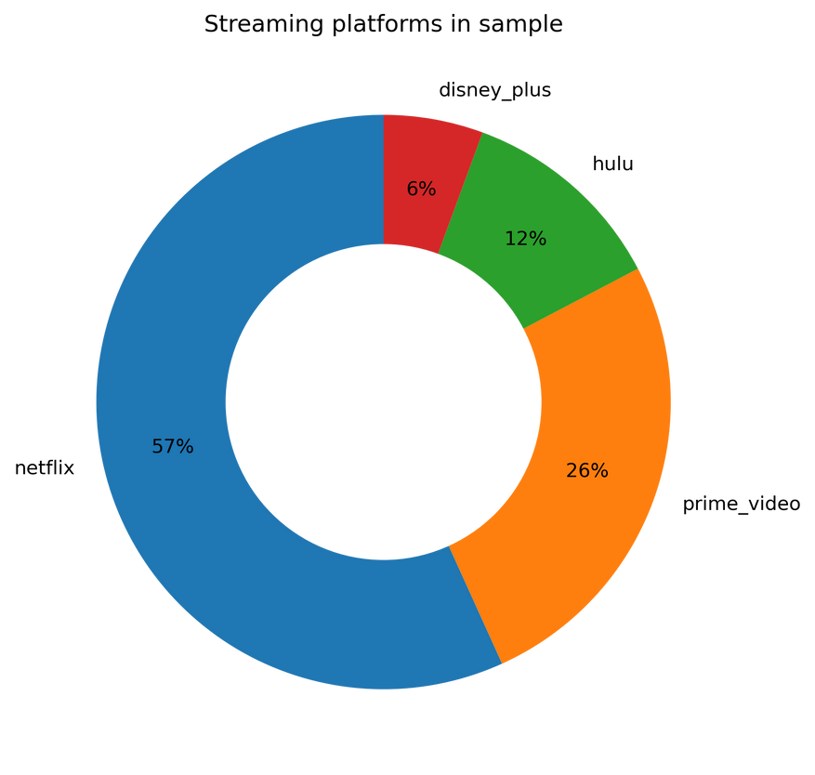
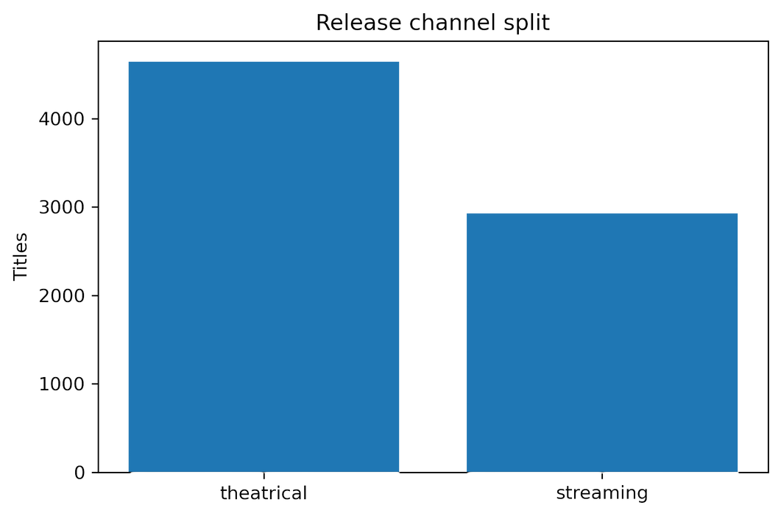
Data & Cohorts
(2018–2024)
04
Two public datasets — TMDb & Streaming Platforms (merged by title + year).
Cleaned & standardized — removed zeros, fixed dates, simplified genres.
Two clear cohorts — Theatrical (box office) and Streaming (platform releases).

Slide 5

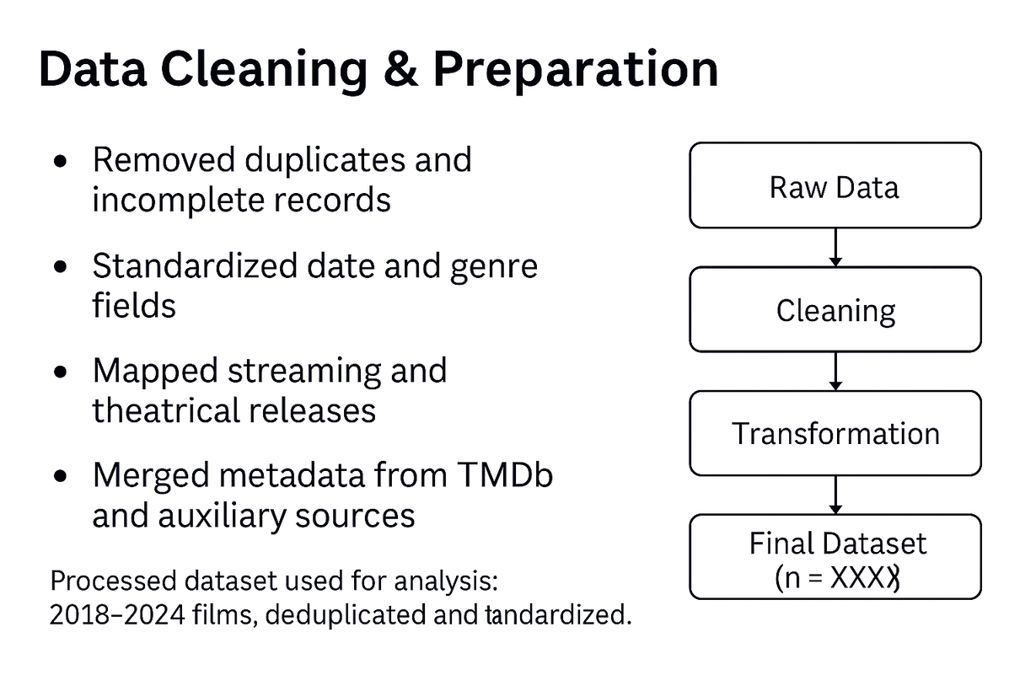
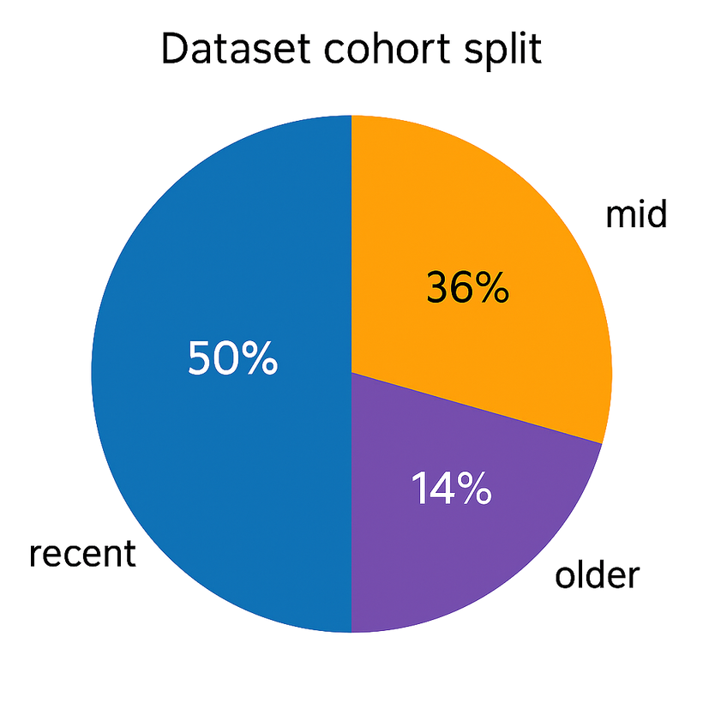
Data Cleaning and Preparation
05

Slide 6

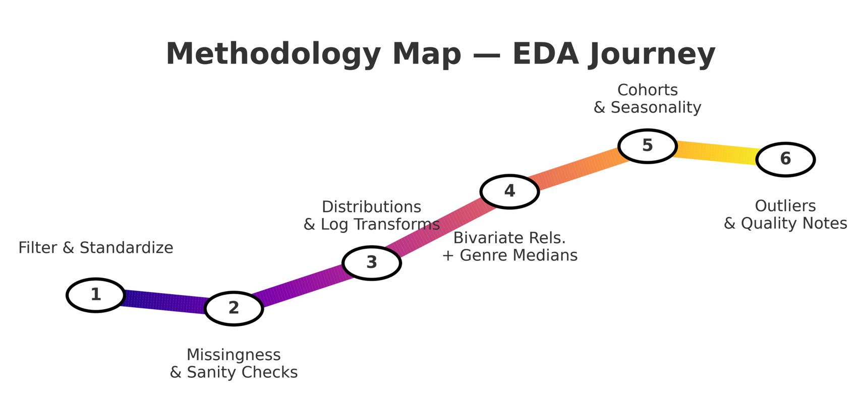
Exploratory Data Analysis
06
Filter 2018–2024; standardize dates/genres/platforms
Missingness & sanity checks (dedupe, invalid dates)
Distributions & log transforms for skewed metrics
Relationships: bivariate; genre one-hot + per-genre medians
Cohorts: franchise vs standalone; seasonality
Outliers & data quality notes

Slide 7
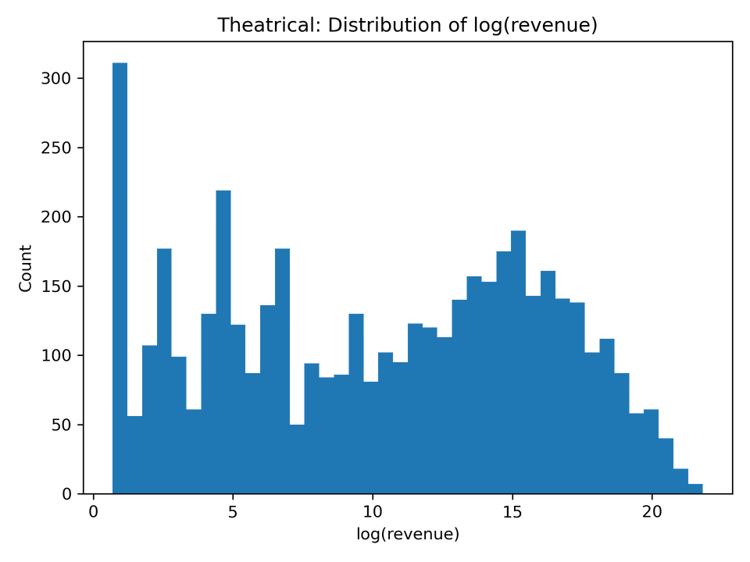
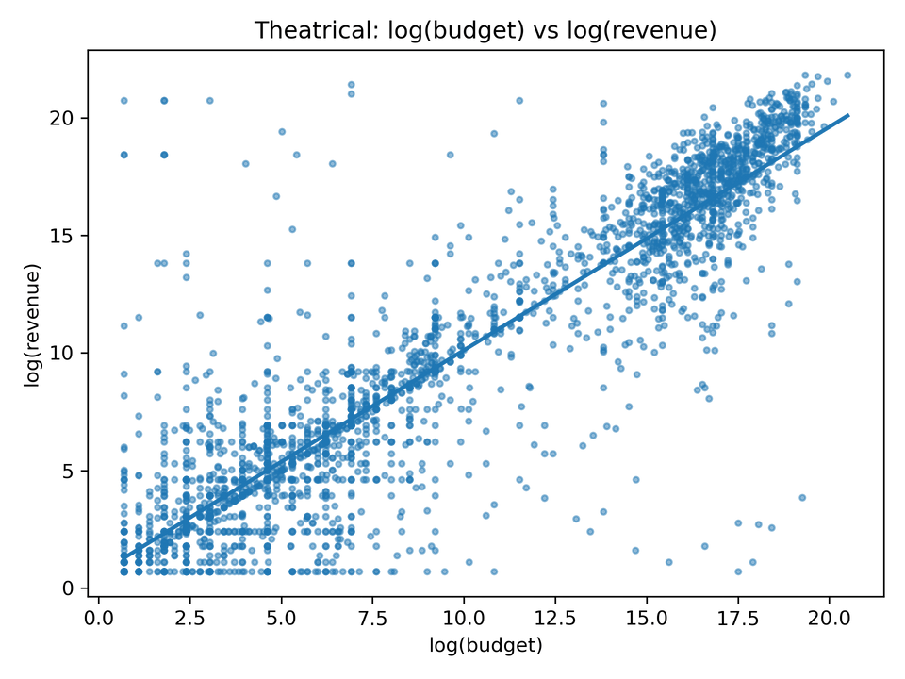
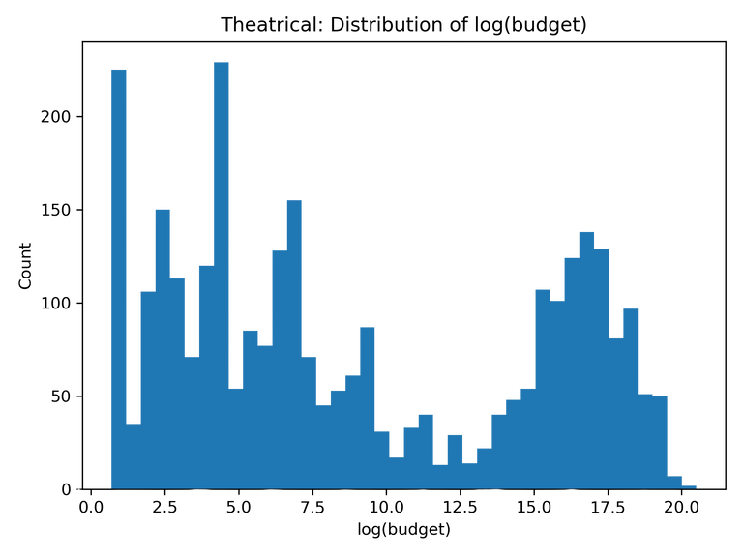
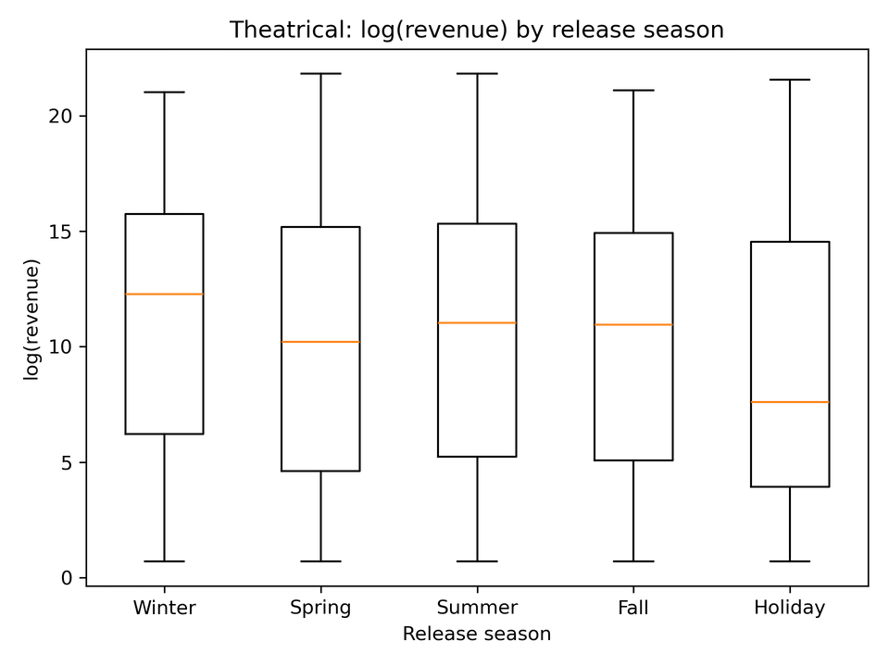
Theatrical EDA Highlights
07

Slide 8
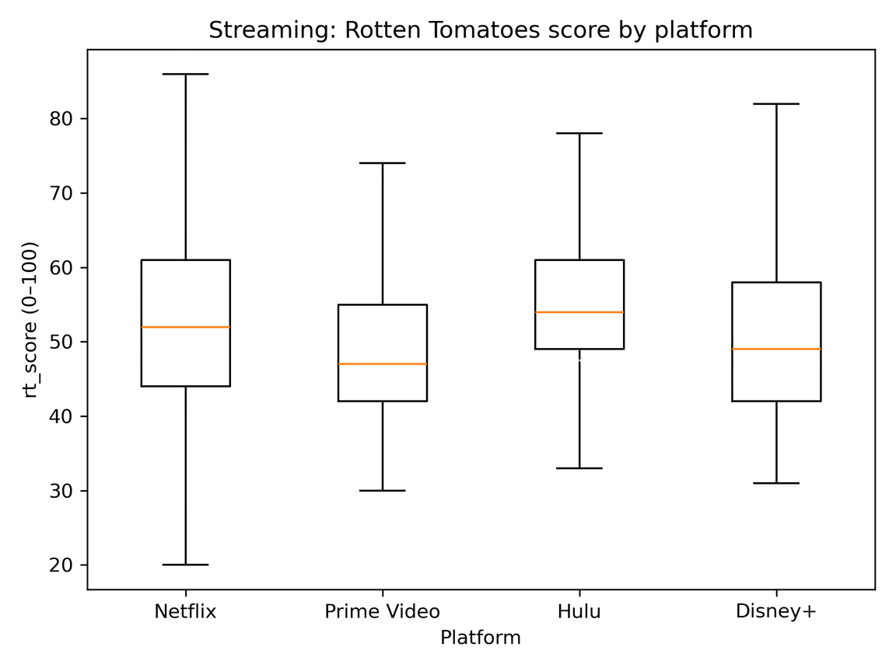
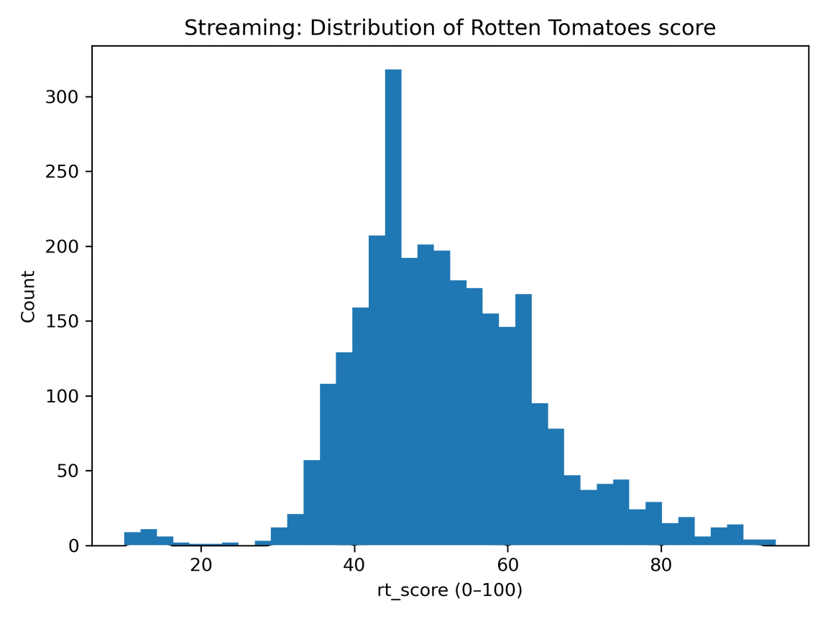
Streaming EDA Highlights
08

Slide 9
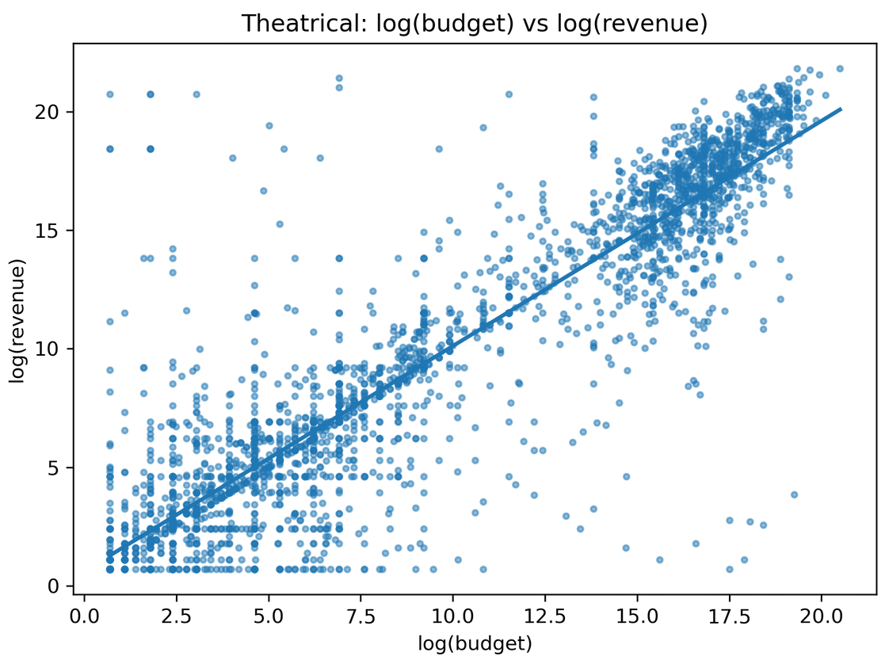
Theatrical Model (Elastic Net)
09
R² 0.610 | MAE (log) 2.56 | Test: 2023–2024
Goal: Predict log(revenue) for theatrical titles
Why Elastic Net: handles correlated features (genres/season), gives sparse, interpretable weights
Inputs: log(budget), season/cohort, franchise flag, runtime, language, genres (one-hot); 5-fold CV on α & l1_ratio.
Log transform justified; strong budget→revenue trend.

Slide 10
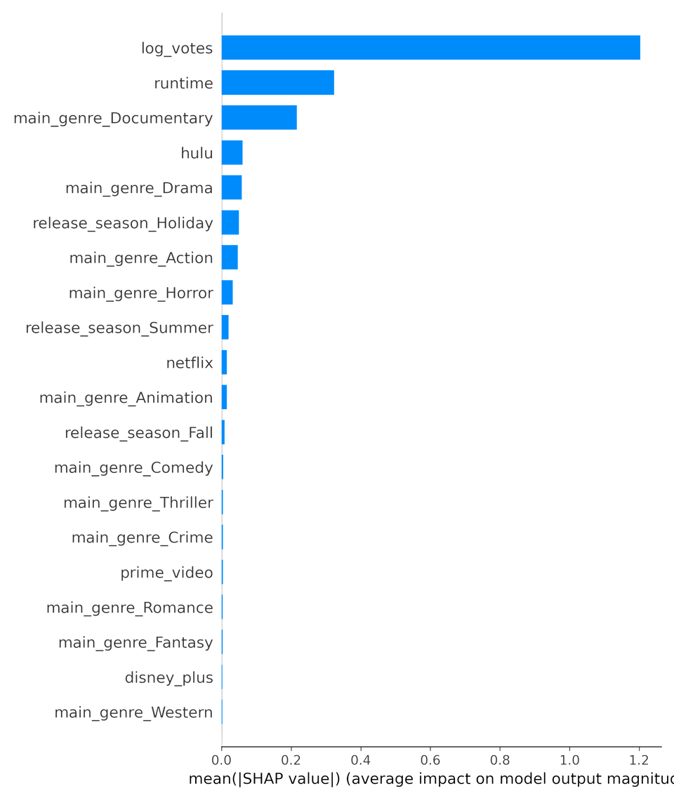
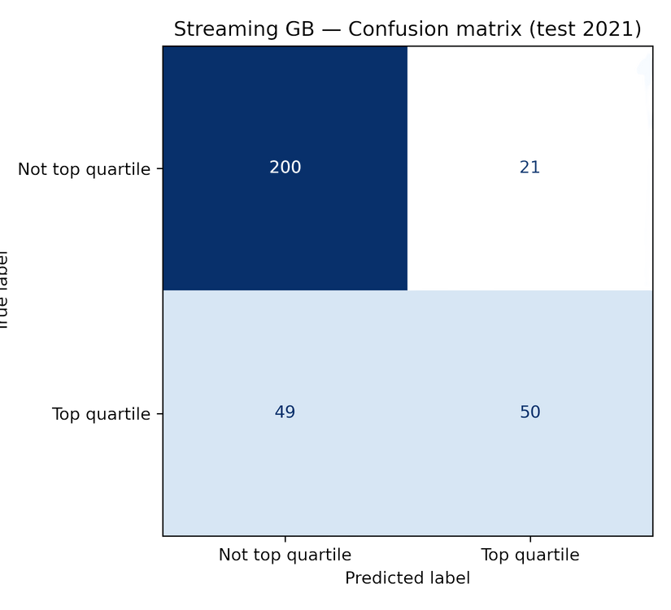
Streaming Model (Gradient Boosting)
10
Goal: Predict Top-quartile RT score (binary)
Why GB: handles nonlinearity & interactions
Class balance: Positive rate ≈ 0.309 (threshold tuned)

Slide 11
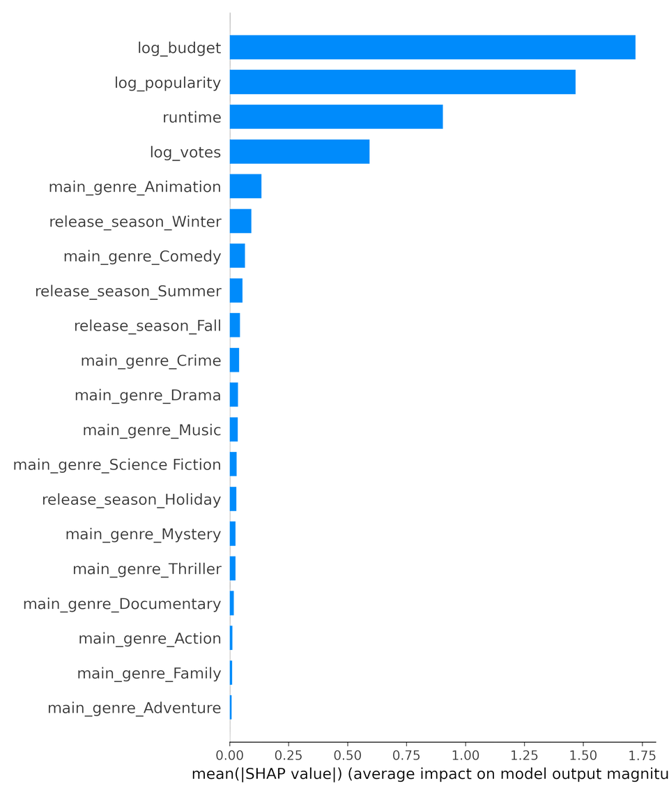
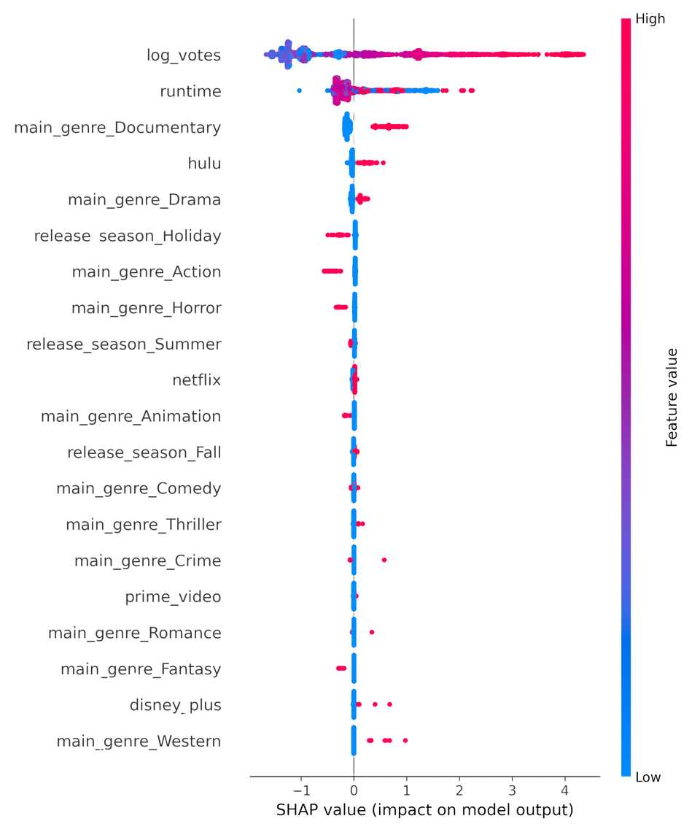
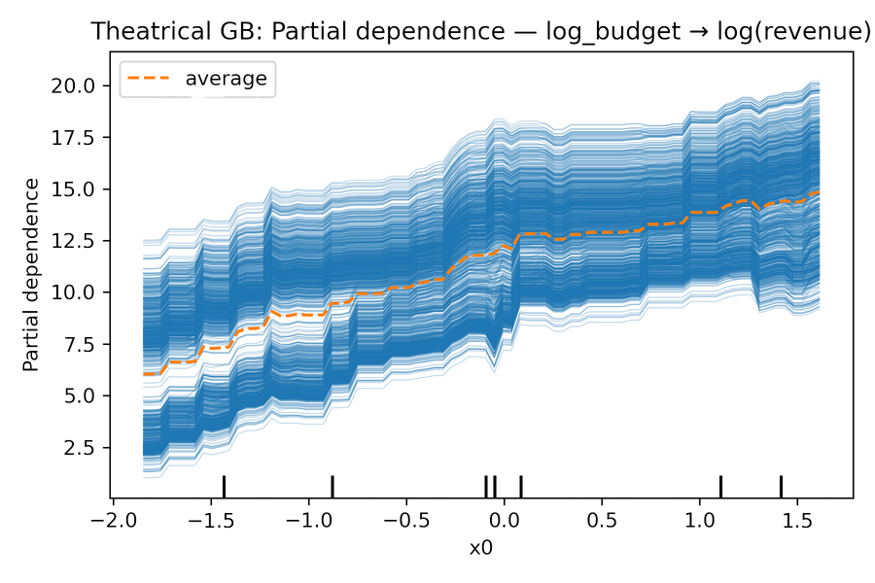
What Drives Outcomes (SHAP & PDP)
11
Theatrical: Budget & popularity dominate; runtime and a few genres/season add lift.
Streaming: Engagement proxy (log_votes) is #1; runtime & Documentary signal matter; platform effects are modest.

Slide 12
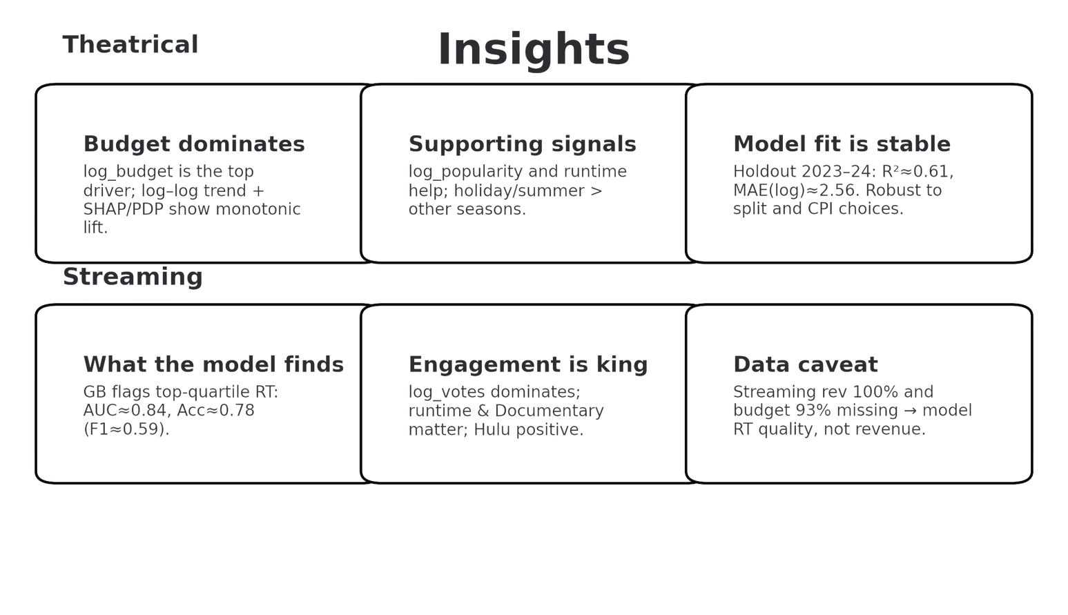
Insights
12
Theatrical: Revenue is budget-led; popularity & runtime help; season is a smaller lift. Model fit is stable across splits and CPI choices.
Streaming: Engagement proxy (log_votes) wins; runtime & Documentary matter; platform effects are modest. We predict quality because revenue/budget are missing.

Slide 13
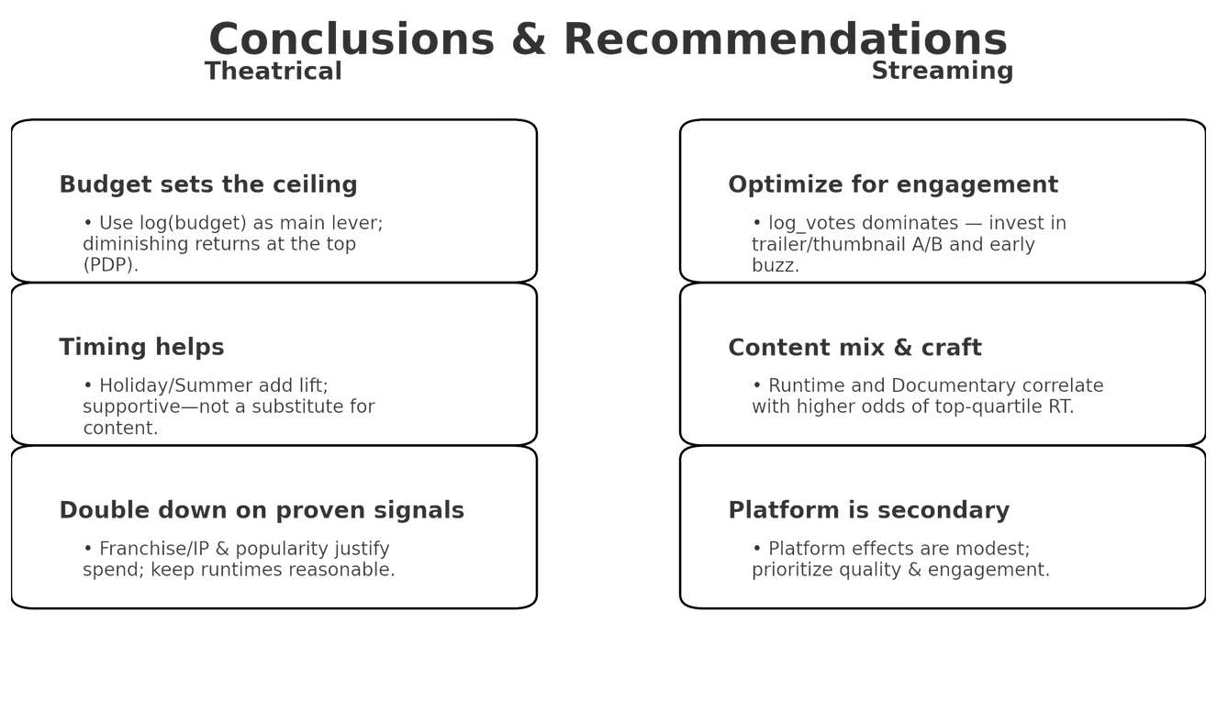
Conclusion and recommendation
13
Theatrical:
Revenue is budget-led; keep log(budget) high but disciplined; expect diminishing returns at the top end.
Time releases to Holiday/Summer where possible; uplift is consistent but not dominant.
Lean into franchises / popularity signals; keep runtime reasonable (PDP suggests long runtimes don’t help much)
Streaming:
Prioritize engagement drivers (trailer/thumbnail/testing) — log_votes is the top predictor of success.
Runtime and Documentary tags correlate with higher top-quartile odds; consider content mix experiments.
Platform effects are modest; quality bar + engagement ops matter more than where it lands.

Slide 14

THANK YOU

